Slide 1
UCSC Drought Net Plots
September 2015
Awaiting Plastic for Shelter “Roof” Panels

Slide 2
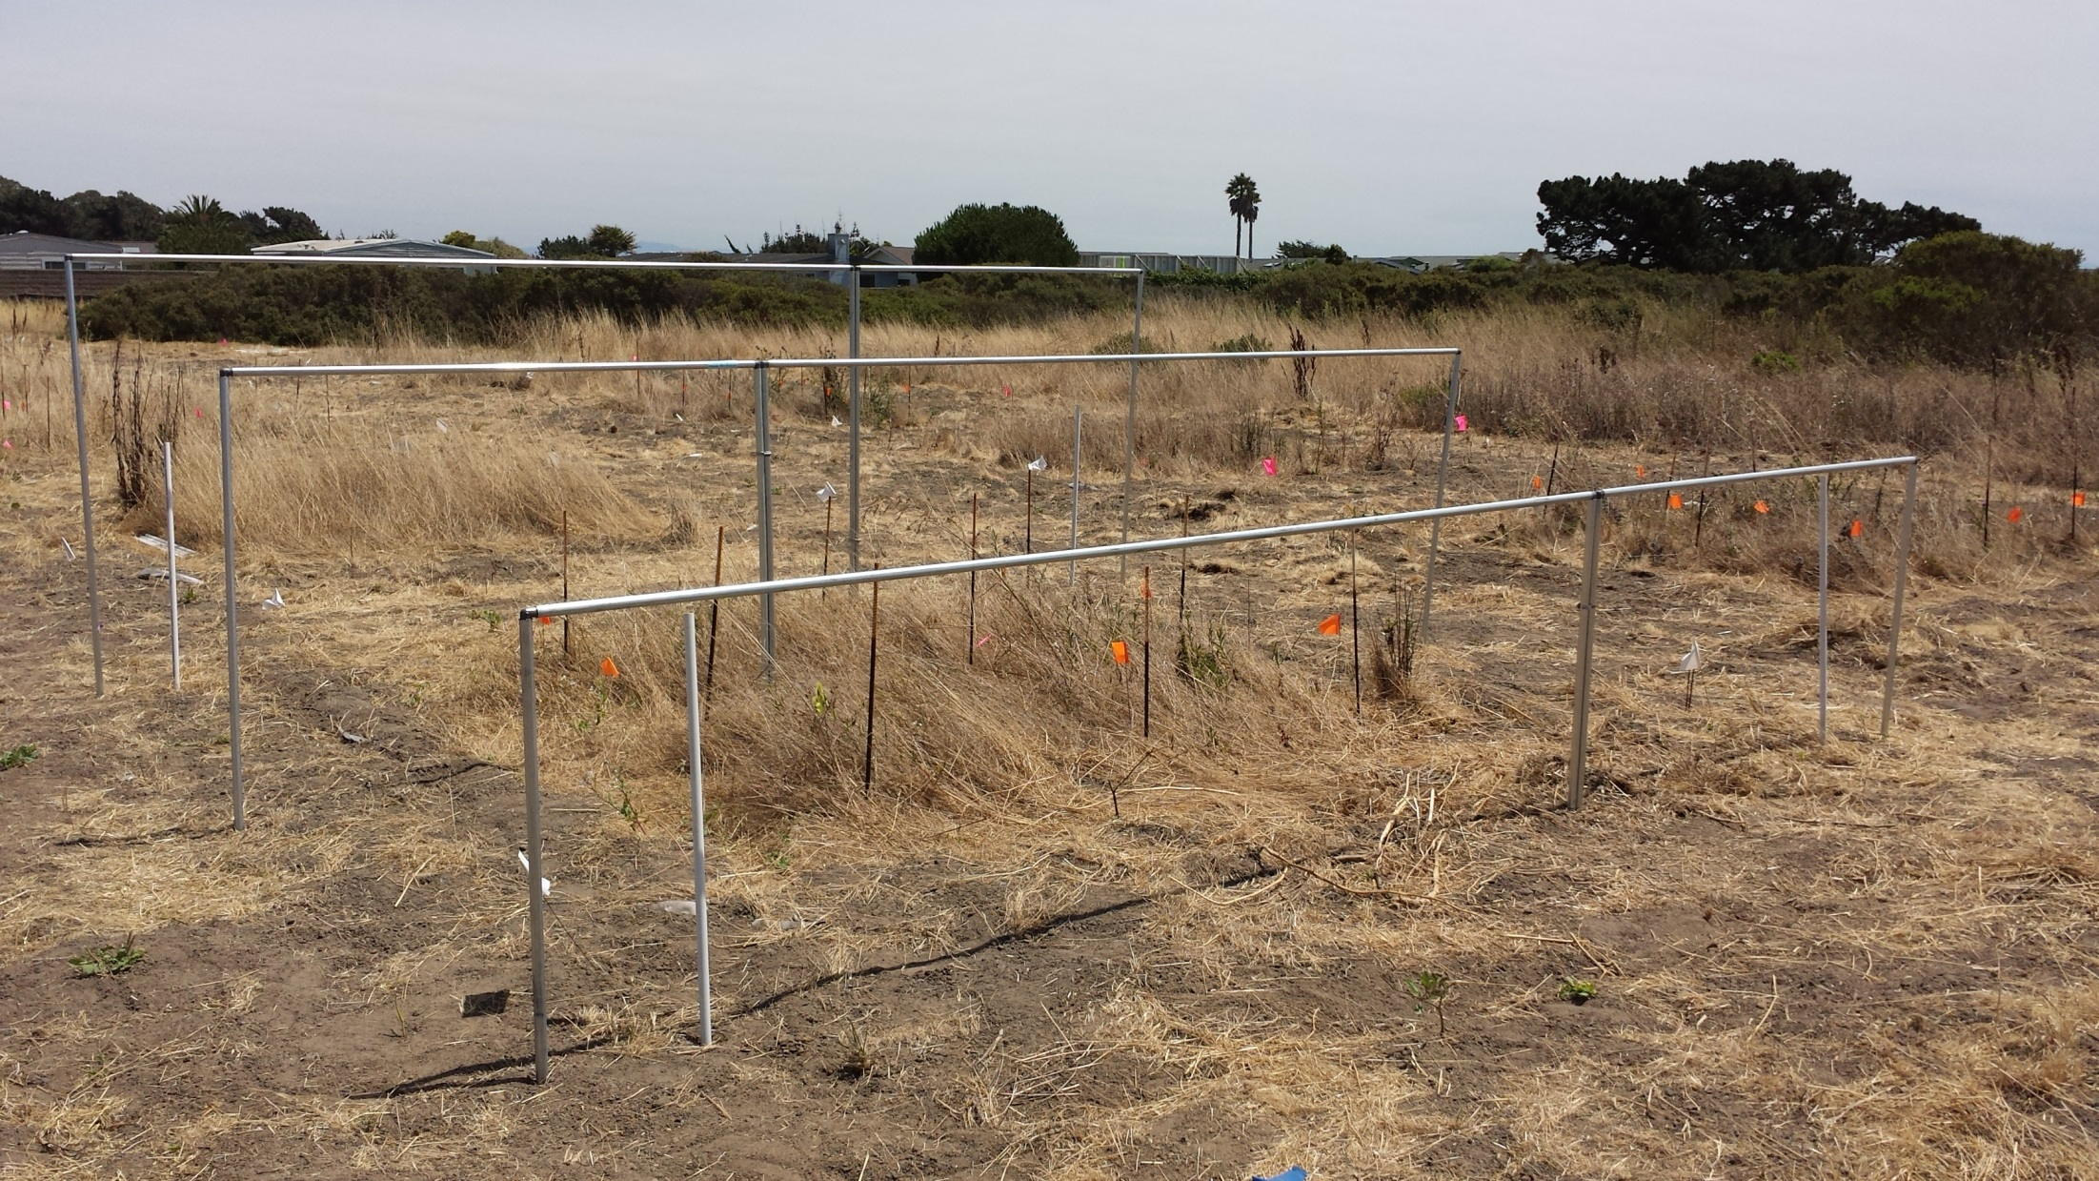
2 m
2 m
4 m
4 m
Notes:
Outer yellow lines (between white PVC posts) delineate the outer boundary of the plots. The inner red lines delineate the 2 x 2 m sampling plots. The space between the red and yellow lines is the plot buffer. The shelters will cover the plot buffers. We will have a roofing gutter below the dripline on the lowest end to catch runoff from the roofs and channel the water away from the plots.

